Slide 1
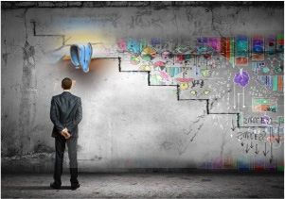

Agile Progress & Program Management
CSSE579
Session 6
Part 1
We discussed day-to-day progress management last week!
How to plan lots of things
Parts of Phillips, Ch 5
Notes:
Image adapted from http://incedogroup.com/whats-the-difference-between-successful-business-strategies-and-business-plans/. http://incedogroup.com/wp-content/uploads/2013/11/20131128-successful-business-strategies-2.jpg

Slide 2
Week 6’s plan
This week – progress, program/portfolio management
This week’s project / presentation activities:
The usual questions, on day-to-day planning, and on risk, and
The WBS investigation! How is this being done?
Systems Engineers take care of it?
They confer with PE’s?
Some other solution?
And – we’ll do the visioning box activity.
Subject – Stand-up meeting with remote people (see email I sent 4/17/15)
Surprise addition – Two courses to consider for summer…
Software architecture – Already discussed (See slides on our web site).
Systems engineering – See next three slides here →
Next week –
A short (take home) test over recent topics – Any questions, so far?
Project management vs designing and testing

Slide 3
Systems Engineering (SE) summer course
This summer I will be teaching a software-flavored version of Rose-Hulman’s master’s level systems engineering course.
I used to be a systems engineer at Bell Labs.
Features will include:
How to make systems engineering work with Agile software development. This is a big deal with combined projects involving software and other kinds of engineering.
How to use tools other than the traditional IDEF style, for doing systems engineering documentation. Systems engineers also are trending toward lighter, software-originated methods.

Slide 4
SE course – main features
We use two books – an intro and a reference with lots of “how to’s”.
We focus on the tasks that systems engineers typically do, like:
Studying the operating environment.
Defining complex systems.
Integrating and testing the many components.
Managing system-wide qualities.
You’ll be able to discuss topics with other working professionals.
You’ll have a chance to do a work-related project!

Slide 5
SE course – How we’ll do it this summer
We’ll teach it as a combination of local / remote, to suit the most people possible. I.e., It could be either in Terre Haute or Indianapolis, depending on who shows interest! Wherever it is, everyone else will connect live, like via Google Hangouts.
There will be at least 3 other people, working software professionals, from our MSSE program - all in different locations. You’ll get to share in their stories from the real world.
Schedule will likely be one night a week for 10 weeks - but I’m willing to adjust this as needed by the people who sign up. E.g., for vacations. I’m not doing it as an online course, but we will try hard to accommodate your varying needs.
Summer tuition is less than our usual (40% discount).
Please ask other people, as well!
It’s even more fun to take it with your friends.

Slide 6

Ch 5 – An agile project management model
The model has layers:
Portfolio governance layer
Project management layer
Iteration management layer
Technical practices layer
Highsmith wants to crank it up a notch, on what “agile” is – it’s getting popular elsewhere.
Notes:
APM pp 77 – 79
Emeril Lagasse picture from http://en.wikipedia.org/wiki/Emeril_Lagasse.

Slide 7
What’s your whole process look like, across organizations?
Probably different in different groups!
At Lucent, we discovered we were using 100 different development environments (for 10000 software developers).
Why should use of Scrum vs its competitors be different?
Typically groups adopt practices and tools for reasons that make sense at the time.
You tend to become stuck in those.
Consider which DBMS you use, for example.

Slide 8

So, for a high-level manager
This reality makes it harder to move people from group to group.
And, it makes it harder for management to look down and tell what’s going on.
If you rate code as “100% complete” only if it’s fully tested, and someone else rates it differently, does the VP of Engineering have to keep these process differences going in his/her head?
90% earned value, eh?
Notes:
Dubious manager from https://sg.news.yahoo.com/five-head-scratching-questions-asked-by-singapore-job-interviewers-085135690.html

Slide 9
Agile should survive this problem
Even if it doesn’t “take over,” it’s supposed to adapt to its situation:
“We improve effectiveness and reliability through situationally specific strategies, processes, and practices.”
But, “utilizing a common framework” makes sense for a large organization.
Highsmith’s 5 layers allow the others to differ.
Notes:
APM, p 77

Slide 10
Portfolio governance layer
Managers want to know about projects in terms of the bottom line, like ROI, and the risk of obtaining that.
They don’t care if the requirements are done or not.
Which tends to irritate us, because technical risk clearly leads to financial risk.
More on this layer in the next slide set.

Slide 11
Project management layer
This is – “Who takes the heat if the project falls behind”?
And how do they operate to achieve product release goals?
They deal with reporting to stakeholders
Internal and external.
Customers and suppliers.
And usually also with “making it happen.”
As per “leading the troops” in some fashion.
Expected to handle the risks.
In agile developments, their role is modified by the fact that the team doesn’t try to guarantee things won’t slip.
And accountable for product release.
Sometimes “product manager.”
But other times that’s the portfolio manager, with several products.

Slide 12
Iteration management layer
Could be the same as the “project manager,” or not. Responsible for their group, during an iteration.
But, the practices can vary from what it takes at the “product level.”
This is especially true for an integrated product.
In Scrum, this person is most likely the “scrum master.”
Who’s the “product owner,” then?

Slide 13
Technical practices layer
Officially, this is identified with how you do the technical work. Like, do you do continuous testing or not?
But, informally, this is identified with you, the software engineer, too.

Slide 14
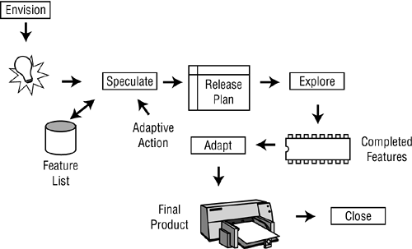
These levels fit with Highsmith’s process steps
Notes:
From http://flylib.com/books/en/1.211.1.35/1/

Slide 15
And with the goals of the framework
Achieve the project’s business goals!
Support a culture where envisioning, adapting, etc., are pursued.
Promote reliability and consistency in projects.
Provide process visibility, including for management.
Incorporate learning and support practices.
Notes:
APM, p 81.

Slide 16
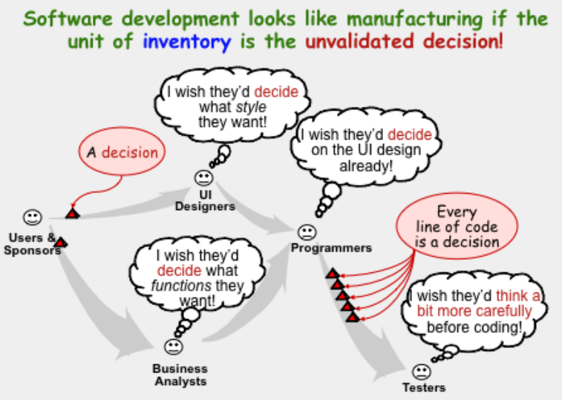
Agile Software Process using “Lean” Thinking
Alistair Cockburn’s Software Engineering in the 21st Century:
http://alistair.cockburn.us/Software+engineering+in+the+21st+century.ppt
So, we borrowed from other endeavors, too!

Slide 17
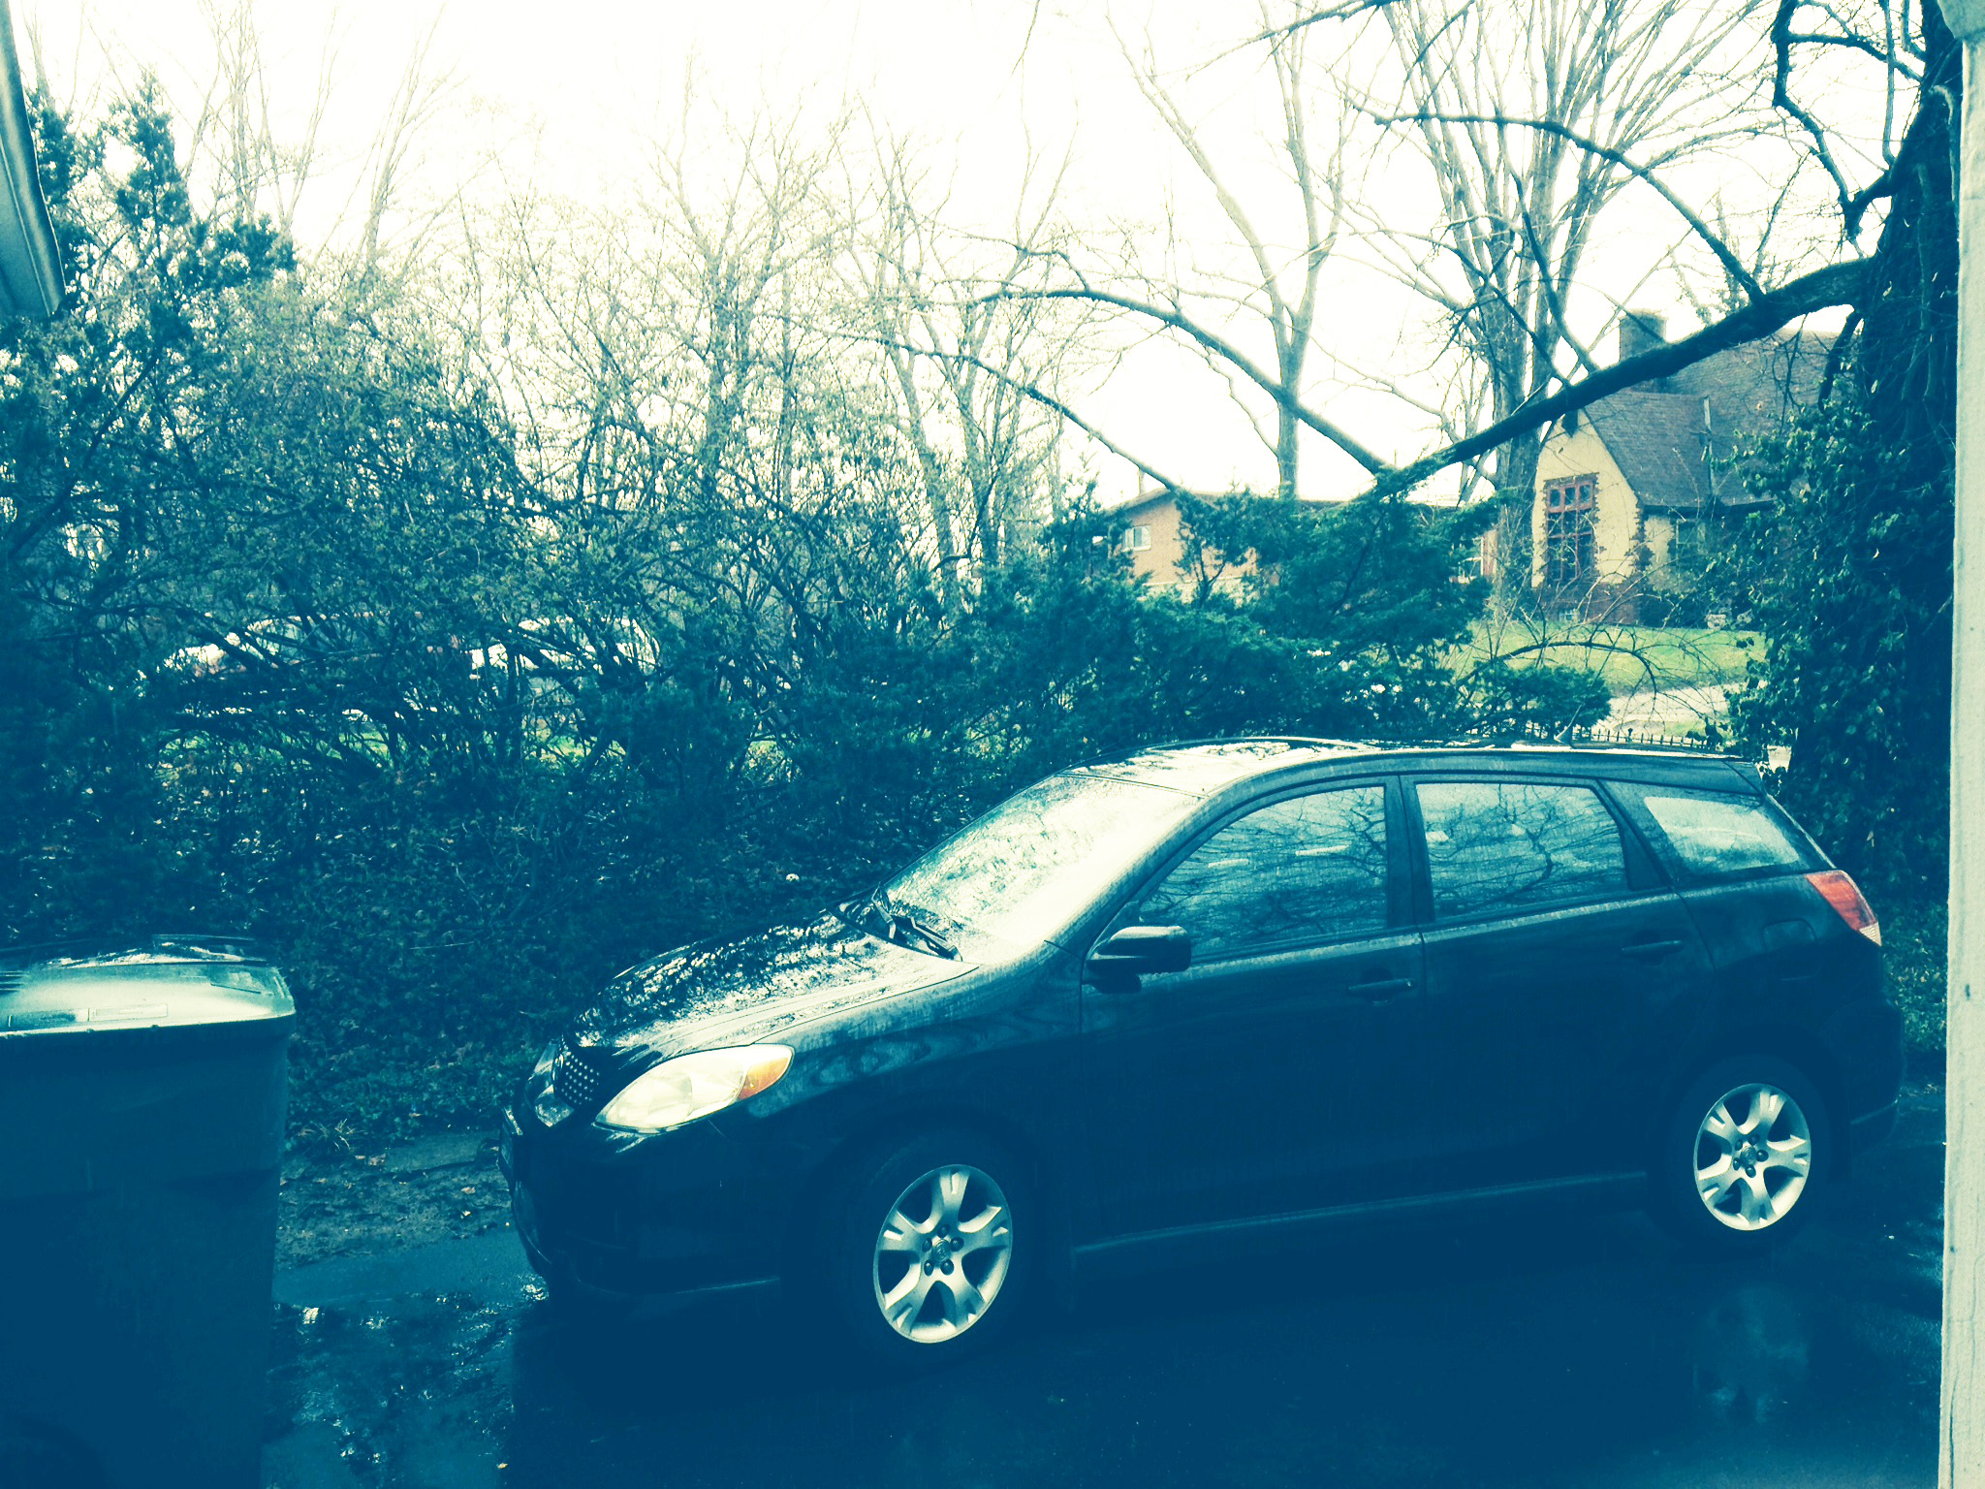
Lean emphasizes…
…making obvious what adds value by reducing everything else.
The original seven muda (wastes) are:
Transport (moving products that are not actually required to perform the processing)
Inventory (all components, work-in-process, and finished product not being processed)
Motion (people or equipment moving or walking more than is required to perform the processing)
Waiting (waiting for the next production step, interruptions of production during shift change)
Overproduction (production ahead of demand)
Over Processing (resulting from poor tool or product design creating activity)
Defects (the effort involved in inspecting for and fixing defects)^{[19]}
Sound familiar?
Right – Not yet ready for those trash cans – My 2004 Toyota Matrix, a product of lean manufacturing, with 306,000 miles on it, and which I use for everyday commuting.
Notes:
List from http://en.wikipedia.org/wiki/Lean_manufacturing.

Slide 18
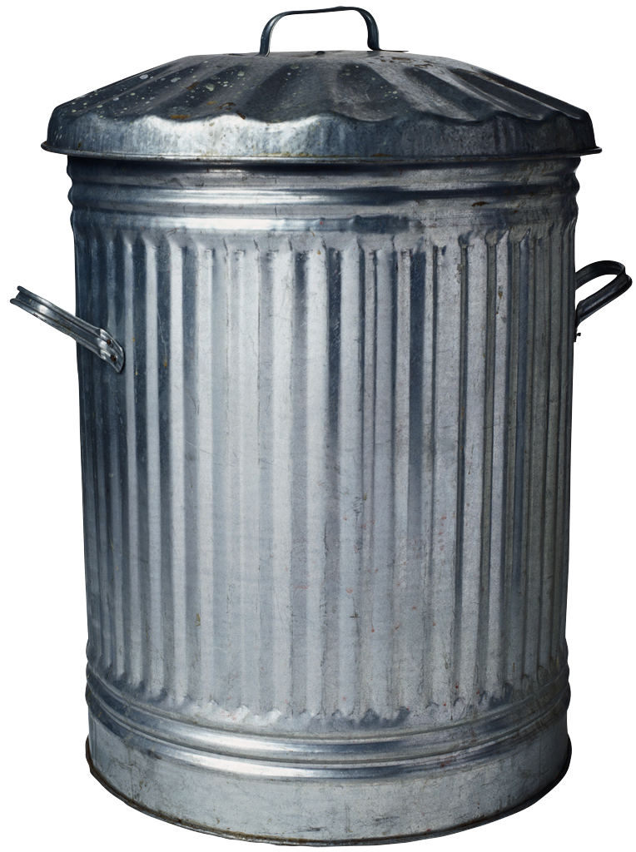
Translation - Seven Wastes of Software Development
Partially Done Work
Extra Processes
Extra Features
Task Switching
Waiting
Motion
Defects
Source: Seven Wastes of SD defined by Mary Poppendieck
Notes:
Partially developed work not released to production (Inventory)
Extra/Unused features (Overproduction)
Intermediate/unused artifacts (Extra Processing)
Handoffs (Transportation)
Waiting (including Customer Waiting)
Seeking Information (Motion)
Escaped defects not caught by tests/reviews (Defects)
8. Underutilization of Employees

Slide 19
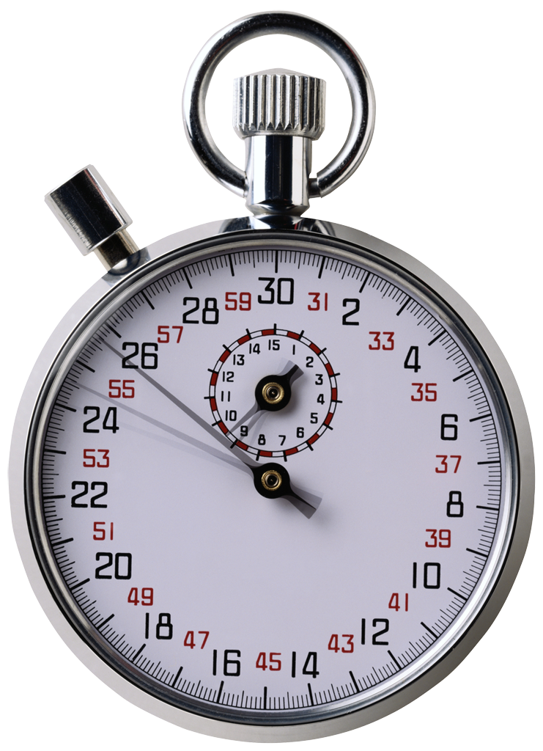
What advantage would you have if you could develop software at 1/3 the effort, 1/3 the cost, and with 1/3 the number of defects?
Think for 15.999 seconds…
Let’s talk…
Notes:
When you have conflict with someone on your project team, is this always bad? [No, Sometimes it is useful for new ideas and change and learning. It depends what you do with the conflict.]

Slide 20
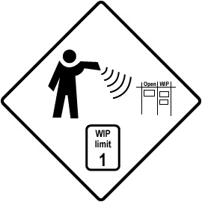
Purpose of Lean Approaches
To eliminate all waste or non value added activities from a process
This is not a “once over” audit but a real-time activity
Not meant to eliminate people, but to use them most wisely

Slide 21
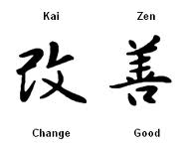
Built into “Lean” is Kaizen
Japanese word that means to make small changes for the better
Changes are best when they are created by the practitioner
They know the context
Person doing the work uses their own common sense and intuition

Slide 22

Defining Lean Thinking (simple, but difficult)
Lean → Kaizen + Respect for People
Kaizen is relentless improvement via small, continuous changes
Respect for People in their roles on teams working towards the goal
Notes:
What is the simple but difficult definition of Lean Thinking? [Lean → Kaizen + Respect for People]
Communicating knowledge about improvement
Elimination of waste (muda)
Reflection on performance
Flow of work towards the goal (minimum friction)
Pursue Perfection (dissatisfied with status quo)

Slide 23


The Lean Thinking House
QUANTITY
QUALITY
Sustainable shortest lead time, best quality and value (to people and society), most customer delight, lowest cost, high morale, saftey
Respect for People
Product Development
Principles
Continuous Improvement
Don’t trouble customer
Develop people, then products
No wasteful work
Evolve teams and individuals…
Build partners – trust, stability, coaching lean…
Kaizen – small, change, spread knowledge, reflect…
Eyes for waste, 5 why’s, variability, over-burden, WIP…
Perfection challenge
Work towards flow – batch size, Que size, cycle time …
Teach and apply lean thinking
Stay in balance, stable while changing
Decisions based on long-term lean
Notes:
The Lean Thinking House
Goal → Roof
Foundation → Teaching and applying Lean thinking, balance, Long-term lean decision-making
Pillar 1 → Respect for people
Pillar 2 → Continuous Improvement
14 Principles
Lean product development

Slide 24
Principles of Lean Software Development
Satisfying the Customer is the Highest Priority
Always Provide the Best Value for Money
Success Depends on Active Customer Participation
Lean Development is a Team Effort
Everything is changeable
Domain, not Point Solutions
Source: Robert Charette
Notes:
Satisfying the Customer is the Highest Priority. Customer requirements and priorities are determined and their responses are important factors
Always Provide the Best Value for Money. Software developed should meet customer’s requirements and at a reasonable price
Success Depends on Active Customer Participation. Customer’s participation is essential to requirement changes and on the spot trade-off decisions
Lean Development is a Team Effort. Collaboration of the various teams based on their diversity is the key to innovative and fast-cycles in development
Everything is changeable. Development team must be ready to adapt to requirements changes and plan to accommodate these changes when they occur
Domain, not Point Solutions. Software that is useable in multiple domains help spread the cost and contributes to the value equation

Slide 25
Principles of Lean Software Development
Complete don’t Construct
80% Solution Today over 100% tomorrow
Minimalism is Essential
Needs determine Technology
Product Growth is Feature Growth, not Size Growth
Source: Robert Charette
Notes:
7. Complete don’t Construct. Whenever possible, “buy rather than build” is a viable strategy for most application development groups (also Build and Deliver, Not Document and Delay)
8. 80% Solution Today over 100% tomorrow. This statement holds true as markets are advancing at such a rapid pace to provide a hundred percent solution
9. Minimalism is Essential. Wastage is kept to a minimal by controlling the level of paperwork, team sizes and having a tight focus on the product scope
10. Needs determine Technology. The objectives of the development should be first identified and then the technology to support it. It is easier to change technology than it is to deliver the business applications
11. Product Growth is Feature Growth, not Size Growth. Products should have change-tolerant features. When new features are explored, the impact on business practices should be considered
Studies have been conducted shows that most of the times 45 percent of the functions created in the applications are not used.

Slide 26

Group Exercise
List your top 5 activities
Rate them from a customer perspective on a scale of 1 – 5 (low – hi)
Think of low scoring items as waste
Take the lowest scoring item and plan to cut the time in half
Notes:
What is slowing you down or getting in the way of doing a good job?
What would help things move faster, better, cheaper?

Slide 27
One lean process - Kanban (revisited) – Governs Excess Work In Process
看板 – Kanban means “visual card” (like a signboard or billboard).
Invented by Taiichi Ohno, at Toyota.
Kanban cards used to govern amount of inventory tied up in Work In Progress (WIP)
On a manufacturing floor or WIP in development.
Kanban cards represent a “currency” showing how WIP is allowed in a system.
Not only is excess inventory waste, time spent producing it could be expended elsewhere .
Notes:
Ref Session 3, Part 1 slides.

Slide 28
Why use Kanban in Software Process?
Iterations have more frequent opportunity to measure progress and inspect software.
…but force development items to be smaller.
Smaller development items are often too small to be valuable and difficult to identify.
Quality of requirements suffers as engineers rush to prepare for upcoming cycles.
Quality of current development suffers when busy engineers are unable to inspect software or answer questions during development.
Quality often suffers as testers race to complete work late in the development time-box.
It’s an informal, believable way to communicate progress which management will like and want to visit!

Slide 29


Decompose Large Process Steps into Tasks for Improved Visibility
When a feature, user story, or work item is large:
Takes longer than a couple days to complete.
Requires that multiple people collaborate on its completion.
Decompose that step into cards to track independently.
Feature to develop
Tasks in progress
Tasks complete
Feature complete
Tasks in queue
High visual impact!
Notes:
Source: Jeff Patton, “Using Kanban Techniques to Control Incremental Development” www.agileproductdesign.com/downloads/patton_kanban.ppt

Slide 30
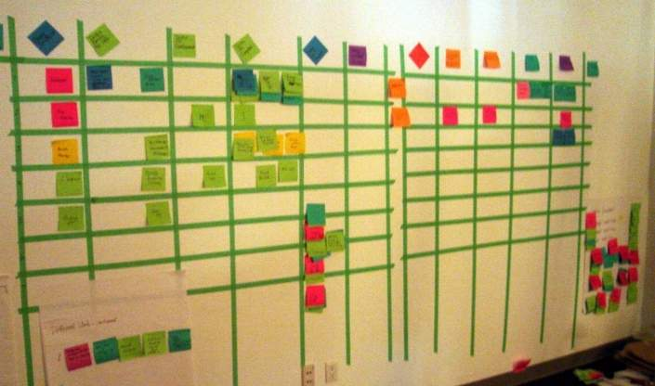
Kanban Board with Task Decomposition
You need the space to put these up, somewhere…
Notes:
Source: Jeff Patton, “Using Kanban Techniques to Control Incremental Development” www.agileproductdesign.com/downloads/patton_kanban.ppt

Slide 31
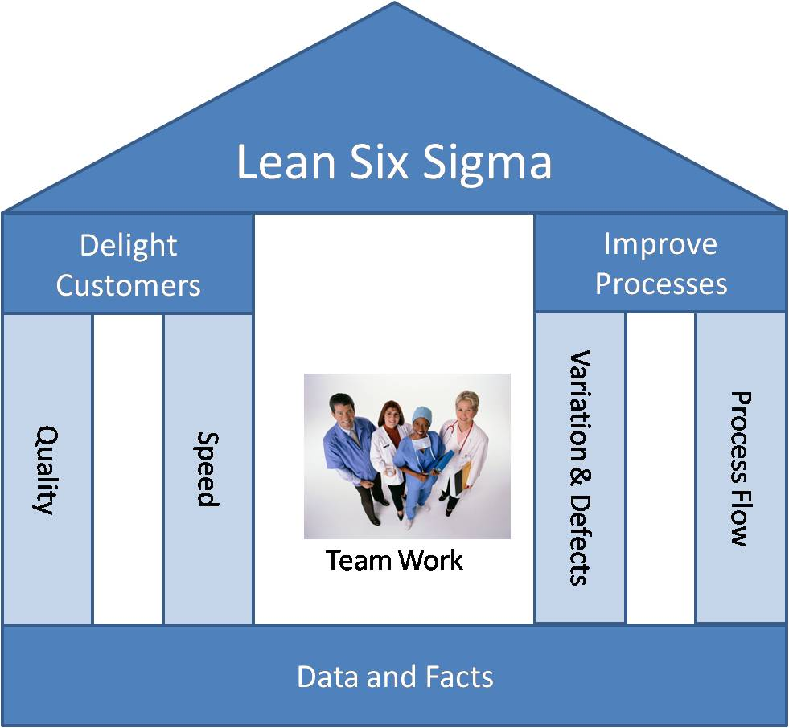

And of course there are mixes… but that overflows to our CSSE 572 – process improvement course ☺
TPS
Notes:
Lean Thinking + Six Sigma + Team Process

Slide 32
Why did we single-out “progress” as a dimension of program management?
In software, more often than not, “who releases first” is the most important thing!
In custom work, it’s a big source of repeat business.
In general product work, it’s “Who’s first to market?”
So, are we back in the land of Microsoft’s “quality triangle”?
Notes:
Their triangle’s dimensions were reliability, features, and schedule.

Slide 33
Agile has this ironic* schedule thing, too…
The most important advantage of agile is its speed of delivery.
(We do also care about quality.)
We are willing to take more risks for that.
Like starting before we get all the requirements.
Yet, if we don’t make it,
It was the schedule’s fault, not ours!
*Irony - a state of affairs or an event that seems deliberately contrary to what one expects and is often amusing as a result.

Slide 34

We do this!
Notes:
Image from the famous EDS commercial showing an airliner being built while flying, from https://www.youtube.com/watch?v=L2zqTYgcpfg.

